Slide 1
Basics of Cryptography

Slide 2
Encryption
Encryption is a part of human history. Since the Roman emperor Gaius Julius Cesar (100–44 BC), many people have tried to create secure encryptions.
The first attempt to create a cryptography system that is considered safe today was made by Frank Miller (1842–1925), who proposed one-time pads to enhance Vigenere encryption.
These problems were partially solved by the German Army during World War II with Enigma. Enigma is a machine that encrypts and decrypts a text by identifying the positions of three rotors and a few patches. This allowed the German Army, particularly the U-boats, to have months of valid codes on a few sheets of paper. This obviously was way less secure than the perfect Vigenere cipher; in fact, it was breached during WWII.

Slide 3

Vigenere cipher
First described by Giovan Battista Bellaso in 1553, the cipher is easy to understand and implement, but it resisted all attempts to break it until 1863, three centuries later.
Plaintext: ATTACKATDAWN
Key: LEMONLEMONLE
Ciphertext: LXFOPVEFRNHR

Slide 4
Types of encryption
Symmetric Encryption
Asymmetric Encryption

Slide 5
Symmetric Encryption
A systems where by knowing the algorithm and the key, you can both encrypt and decrypt a message. This kind of encryption is known as symmetric encryption.
The big advantage of this kind of encryption is that it is easy because it does not require complex math and much calculation to execute.
On the other hand, it makes critical the key exchange moment and key management. In fact, the key has to be exchanged before the transmission can start between the parties, and it has to be done securely.

Slide 6
Symmetric Encryption
As for the key management problem, since both parties know the same secret (in fact, this kind of cryptography is also called shared secret), if you have multiple people that have to communicate with each other, you will need n(n-1)/2 keys
This means that in a group of 20 people, you’ll need 190 keys.

Slide 7
Symmetric Encryption
The following is the schema of a communication using a symmetric encryption.
The types of symmetric encryption that are used are as follows:
Stream cipher (ex, RC4) (WEP, WPA, SSL, TSL)
Block cipher (AES, DES, 3DES)

Slide 8
ASymmetric Encryption
Asymmetric encryption has some core differences from symmetric encryption.
The first that you can immediately notice is that in asymmetric encryption there are two keys: one public key to encrypt and a private key to decrypt.
From this concept, one of the names of asymmetric encryption is derived: public key encryption.
This approach does simplify greatly the key exchange and key management. For the key management, you only need a pair of keys (private/public) for each person. So if you have 20 people that have to communicate between themselves, you'll only need 20 pairs of keys.

Slide 9
ASymmetric Encryption
Asymmetric encryption also allows you to sign messages, encrypting them with your private key, so that anyone with your private key can decrypt the message, understanding that it is coming from you and granting non-repudiation.
The process in an exchange of secure data with an asymmetric encryption is as seen here.
The types of asymmetric encryption that are used are as follows:
Diffie-Hellman (IPSec)
RSA Algorithm
Elliptic Curve Cryptography

Slide 10
comparison
Domain | Symmetric | Asymmetric
Able to grant | Confidential | Confidential, Offering Integrity, Authentication, and Non-repudiation
Needed keys | A single shared key | A public Key and A private Key
Key Exchange | Complex | Simple
Scalability | Not scalable, keys increase exponentially | Scalable
Key Size | small | Big
Implementation Speed | Fast | Slow
Best for | Bulk Data | Small amount of data, key exchange, digital envelopes, digital signatures and digital certificate

Slide 11
hashing
While encryption is about confidentiality, hashing is about integrity and authentication.
Hashing algorithms reduce any amount of data to a fixed length value known as the hash value.
This hash value is a sort of fingerprint of the initial data.
Due to the algorithms used to create hash values, even small changes in the initial data will create huge changes in the hash value.
This makes it harder to guess the initial data with a trial-and-error approach.
Hashing is a one-way algorithm.

Slide 12
hashing
Since we can have initial data of the desired length, and the output will be of fixed length, there is a possibility that different initial data will have the same hash value. This is called collision.
A well-designed algorithm should prevent collision; but the only way to create an algorithm that is collision-free would need a hash value longer than the text, making it pointless.

Slide 13
hashing
It is not possible to extract the original data by knowing the hash value.
For some hashing algorithms like MD5 that today have a huge number of collisions, you can simply Google a hash value, which will often give you a short string that matches that hash value.
This does not mean that the original message that created that hash value will be the one you have found on Google.

Slide 14
hashing
Hashing can be used to check if a file you have received is the same as the one that has been sent.
It can also be used to check if a password given by the user is the right one to authenticate the user without really knowing the password, since you only stored the algorithm.

Slide 15
MD5
Message Digest 5 is the most famous MD hashing algorithm and is one of the best-known of all hashing algorithms.
It produces a 128-bit output(32 characters), processing the initial data in 512-bit blocks.
Currently, MD5 is deprecated due to its high number of collisions.

Slide 16
SHA
The Secure Hash Algorithm is another series of algorithms like MD5. The various algorithms that constitute the SHA series are:
SHA0 – This is the first version of SHA and was withdrawn shortly after publication since a significant flaw was identified in the hashing algorithm itself.
SHA1 – This produces 160-bit output and today it is considered at risk of breaking since it doesn’t offer much security.
SHA2 – This is set of algorithms that can create outputs of 224-bit, 256-bit, 384 bits and 512 bit. It is considered safe since it can offer fom 112 to 256 bits of security.
SHA3 – This set of algorithms can create output like the SHA2 but with entirely different algorithm, which is based on the Keccak algorithm

Slide 17
Identification versus authentication versus authorization
Identification: This is an action in which the user (untrusted party) declares his identity
Authentication: This is an action(s) to prove that the user is who he claims to be
Authorization: This action(s) is required to determine which actions a specific user can perform

Slide 18
Authentication
Authentication is one of the most attacked processed by malicious users, because it could be the weak link in the security chain.
There are instances when it is enough to be authenticated with a single method (single factor authentication), while there are other cases where more security is needed, so a multiple factor authentication is preferred.

Slide 19
Authentication
The authentication can be performed in three different ways based on what you use to identify the person:
Something you know: This is a way to identify a user using something like a PIN, a password, or a passphrase
Something you have: This is a way to identify a user using something like a smart card or a badge
Something you are: This is a way to identify a user using biometrical characteristics of the user.

Slide 20
authorization
The authorization is the third and last step of the process. The goal of authorization is to be sure that the given user has clearance to do what he is asking to do.
It is important that the three steps of the chain—identification, authentication, and authorization—are performed correctly, because if one of them fails, the whole security chain will fail.
There are multiple ways to grant privileges to a user, based on the access control model the system uses. The main access control models are:
Mandatory Access Control (MAC)
Discretionary Access Control (DAC)
Role-based Access Control (RBAC)
Lattice-based Access Control (LBAC)

Slide 21
Cryptographic Hash Function
For a hash function to be cryptographically secure, it must have the following three additional properties
Collision-resistance
Hiding
Puzzle-friendliness

Slide 22
Property 1 : Collision-Resistance
The first property that we need from a cryptographic hash function is that it’s collision-resistant.
A collision occurs when two distinct inputs produce the same output.
A hash function is collision-resistant if nobody can find a collision.

Slide 23
Property 1 : Collision-Resistance
A logical question here can be, What is collision-resistance useful for?
It is useful for message digest.
Consider XYZBox, an authenticated online file storage system that allows users to upload files and ensure their integrity when they download them. Suppose that Pandeyji uploads really large file, and wants to be able to verify later that the file He downloads is the same as the one He uploads. One way to do that would be to save the whole big file locally, and directly compare it to the file He downloads. While this works, it largely defeats the purpose of uploading it in the first place; if Pandeyji needs to have access to a local copy of the file to ensure its integrity, He can just use the local copy directly.

Slide 24
Property 1 : Collision-Resistance
Collision‐free hashes provide an elegant and efficient solution to this problem.
Pandeyji just needs to remember the hash of the original file. When he later downloads the file from XYZBox, he computes the hash of the downloaded file and compares it to the one he stored. If the hashes are the same, then he can conclude that the file is indeed the one he uploaded, but if they are different, then Pandeji can conclude that the file has been tampered with. Remembering the hash thus allows him to detect accidental corruption of the file during transmission or on XYZBox’s servers, but also intentional modification of the file by the server.
Such guarantees in the face of potentially malicious behavior by other entities are at the core of what cryptography gives us.

Slide 25
Property 2 : Hiding
The hiding property asserts that if we’re given the output of the hash function y = H(x), there’s no feasible way to figure out what the input, x, was.
The problem is that this property can’t be true in the stated form. Consider the following simple example: we’re going to do an experiment where we flip a coin. If the result of the coin flip was heads, we’re going to announce the hash of the string “heads”. If the result was tails, we’re going to announce the hash of the string “tails”. We then ask someone who didn’t see the coin flip, but only saw the hash output, to figure out what the string was that was hashed.

Slide 26
Property 2 : Hiding
The big question is: can we achieve the hiding property when the values that we want do not come from a spread‐out set as in our “heads” and “tails” experiment? Fortunately, the answer is yes! So perhaps we can hide even an input that’s not spread out by concatenating it with another input that is spread out. We can now be slightly more precise about what we mean by hiding.
A hash function H is hiding if: when a secret value r is chosen from a probability distribution that has high min‐entropy, then given H(r ‖ x) it is infeasible to find x.
(Min-entropy is a measurement of how predictable an outcome is.)

Slide 27
Property 2 : Hiding
This property is majorly useful in commitment.
A commitment is the digital analog of taking value, sealing it in an envelope and putting that envelope out on the table where everyone can see it. When you do that, you’ve committed yourself to what’s inside the envelope. But you haven’t opened it, so even though you’ve committed to a value, the value remains a secret from everyone else. Later, you can open the envelope and reveal the value that you committed to earlier.

Slide 28
Property 3 : Puzzle friendliness
The hash function must need to be puzzle friendly.
A hash function H is said to be puzzle‐friendly if for every possible n‐bit output value y, if k is chosen from a distribution with high min‐entropy, then it is infeasible to find x such that H(k ‖ x) = y in time significantly less than 2^{n}
If someone wants to target the hash function to come out to some particular value-y, that if there’s part of the input that is chosen in suitably randomized way, it is very difficult to find another value that hits exactly that target.

Slide 29
Property 3 : Puzzle friendliness
Now, let’s consider an application that illustrates the usefulness of this property.
In this application, we’re going to build a search puzzle, a mathematical problem which requires searching a very large space in order to find the solution. In particular, a search puzzle has no shortcuts.
That is, there’s no way to find a valid solution other than searching that large space.

Slide 30
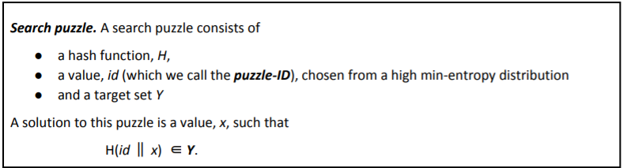
Property 3 : Puzzle friendliness
if H has an n‐bit output, then it can take any of 2^{n} values.
Solving the puzzle requires finding an input so that the output falls within the set Y, which is typically much smaller than the set of all outputs.

Slide 31
Property 3 : Puzzle friendliness
The size of Y determines how hard the puzzle is. If Y is the set of all n‐bit strings the puzzle is trivial, whereas if Y has only 1 element the puzzle is maximally hard. The fact that the puzzle id has high min‐entropy ensures that there are no shortcuts.

Slide 32
Property 3 : Puzzle friendliness
On the contrary, if a particular value of the ID were likely, then someone could cheat, say by pre‐computing a solution to the puzzle with that ID.

Slide 33
Property 3 : Puzzle friendliness
If a search puzzle is puzzle‐friendly, this implies that there’s no solving strategy for this puzzle which is much better than just trying random values of x.
And so, if we want to pose a puzzle that’s difficult to solve, we can do it this way as long as we can generate puzzle‐IDs in a suitably random way.
We’re going to use this idea later when we talk about Bitcoin mining, which is a sort of computational puzzle.

Slide 34
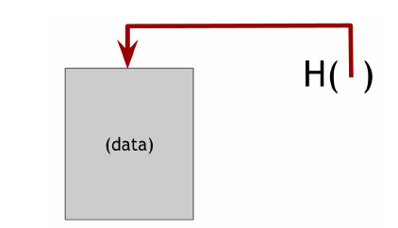
Hash-pointers
A hash pointer is simply a pointer to where some information is stored along with a cryptographic hash of the information.
Regular pointer gives a way to retrieve the information, hash pointer also gives you a way to verify that information hasn’t changed.
We can use hash pointers to build all kinds of data structures.
Intuitively, We can take a familiar data structure that uses pointer such as a binary search tree and implement it with hash pointers.

Slide 35
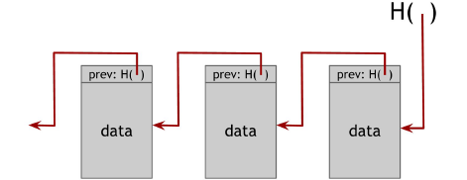
Blockchain with hash pointers

Slide 36
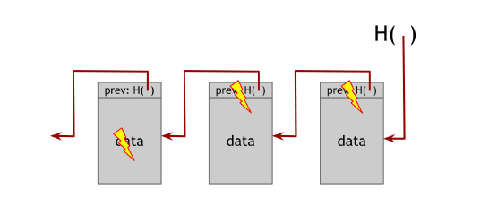
Blockchain with hash pointers
This provides blockchain a tamper-evident property.
Let’s discuss what happens if an adversary wants to tamper with data that’s in the middle of the chain.

Slide 37
Digital Signature
Digital signature is supposed to be the digital analog to a handwritten signature on paper.
We desire two properties from digital signatures that correspond well to the handwritten signature analogy.
Firstly, only you can make your signature, but anyone who sees it can verify that it’s valid. Secondly, we want the signature to be tied to a particular document so that the signature cannot be used to indicate your agreement or endorsement of a different document.

Slide 38
Digital Signature Scheme
A digital signature scheme consists of the following three algorithms:
(sk,pk) := generateKey(keysize) The generateKeys method takes a key size and generates a key pair. The secret key sk is kept privately and used to sign messages. pk is the public verification key that you give to everybody. Anyone with this key can verify your signature.
sig := sign( sk , message ) The sign method takes a message and a secret key, sk , as input and outputs a signature for message under sk
isValid := verify( pk , message , sig ) The verify method takes a message, a signature, and a public key as input. It returns a boolean value, isValid , that will be true if sig is a valid signature for message under public key pk , and false otherwise.

Slide 39
ECDSA
Bitcoin uses a particular digital signature scheme that’s called the Elliptic Curve Digital Signature Algorithm (ECDSA).
ECDSA is a U.S. government standard, an update of the earlier DSA algorithm adapted to use elliptic curves. These algorithms have received considerable cryptographic analysis over the years and are generally believed to be secure.
More specifically, Bitcoin uses ECDSA over the standard elliptic curve “secp256k1” which is estimated to provide 128 bits of security.

Slide 40
Simple Cryptocurrency
Let’s move from cryptography to cryptocurrencies and understand why cryptographic operations like hash functions and digital signatures are actually useful.
Here we will discuss two simple cryptocurrencies.

Slide 41
Goofycoin
Goofycoin is about the simplest cryptocurrency we can imagine.
There are just two rules of GoofyCoin. The first rule is that a designated entity, Goofy, can create new coins whenever he wants and these newly created coins belong to him.

Slide 42
Goofycoin
To create a coin, Goofy generates a unique coin ID uniqueCoinID that he has never generated before and constructs the string “CreateCoin [uniqueCoinID]”. He then computes the digital signature of this string with his secret signing key.
The string, together with Goofy’s signature, is a coin.
Anyone can verify that the coin contains Goofy’s valid signature of a CreateCoin statement, and is therefore a valid coin.

Slide 43
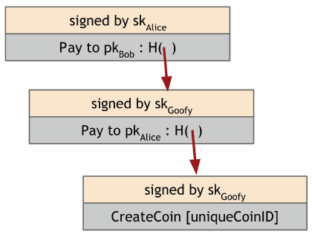
Goofycoin
The second rule of GoofyCoin is that whoever owns a coin can transfer it on to someone else.
Transferring a coin is not simply a matter of sending the coin data structure to the recipient.
It’s done using cryptographic operations.
Notes:
Let’s say Goofy wants to transfer a coin that he created to Alice. To do this he creates a new
statement that says “Pay this to Alice” where “this” is a hash pointer that references the coin in
question. And as we saw earlier, identities are really just public keys, so “Alice” refers to Alice’s public
key. Finally, Goofy signs the string representing the statement. Since Goofy is the one who originally
owned that coin, he has to sign any transaction that spends the coin. Once this data structure
representing Goofy’s transaction signed by him exists, Alice owns the coin. She can prove to anyone
that she owns the coin, because she can present the data structure with Goofy’s valid signature.
Furthermore, it points to a valid coin that was owned by Goofy. So the validity and ownership of coins
are self‐evident in the system.

Slide 44
Summarizing the rules of goofycoin
Goofy can create new coins by simply signing a statement that he’s making a new coin with a unique coin ID.
Whoever owns a coin can pass it on to someone else by signing a statement that saying, “Pass on this coin to X” (where X is specified as a public key)
Anyone can verify the validity of a coin by following the chain of hash pointers back to its creation by Goofy, verifying all of the signatures along the way.

Slide 45
Security problem with Goofycoin
there’s a fundamental security problem with GoofyCoin. Let’s say Alice passed her coin on to Bob by sending her signed statement to Bob but didn’t tell anyone else.
She could create another signed statement that pays the very same coin to Chuck. To Chuck, it would appear that it is perfectly valid transaction, and now he’s the owner of the coin.
Bob and Chuck would both have valid‐looking claims to be the owner of this coin. This is called a double‐spending attack — Alice is spending the same coin twice.
Intuitively, we know coins are not supposed to work that way.

Slide 46
Security problem with Goofycoin
In fact, double‐spending attacks are one of the key problems that any cryptocurrency has to solve.
GoofyCoin does not solve the double‐spending attack and therefore it’s not secure.
GoofyCoin is simple, and its mechanism for transferring coins is actually very similar to Bitcoin, but because it is insecure it won’t cut it as a cryptocurrency.

Slide 47
Scrooge coin
To solve the double-spending problem, A new cryptocurrency can be designed.
ScroogeCoin is built off of GroofyCoin, But it is more complicated in terms of data structures.
The first key idea is that a designated entity called scrooge publishes an append-only ledger containing the history of all the transactions that have happened.
The append-only property ensures that any data written to this ledger will remain forever.
If the ledger is truly append-only, we can use it to defend against double-spending by requiring all transactions to be written to the ledger before they are accepted.
That way, it will be publicly visible if coins were previously sent to a different owner.

Slide 48
Scrooge coin
To implement this append‐only functionality, Scrooge can build a block chain which he will digitally sign. It’s a series of data blocks, each with one transaction in it.
Each block has the ID of a transaction, the transaction’s contents, and a hash pointer to the previous block.
Scrooge digitally signs the final hash pointer, which binds all of the data in this entire structure, and publishes the signature along with the block chain.

Slide 49
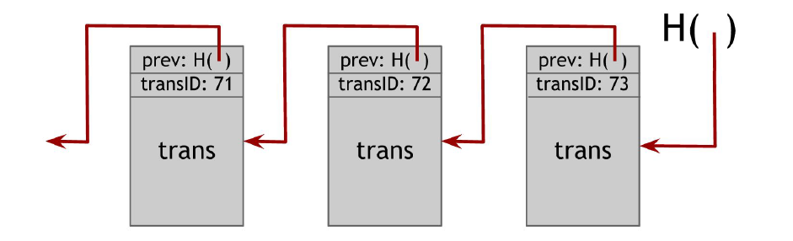
Scrooge coin
In Scrooge Coin a transaction only counts if it is in the block chain signed by Scrooge. Anybody can verfify that a transaction was endorsed by Scrooge by checking scrooge’s signature on the block that it appears in.
Scrooge makes sure that he doesn’t endorse a transaction that attempts to double-spend an already spent coin.

Slide 50
Two General Problem
This problem seems to be very simple, but this was unsolved as of today. So, let’s understand this in detail.
This problem states a scenario where two generals are attacking a common enemy, both the generals has its own army and they will be able to defeat the enemy only if they both attack at same time, if any one of them does not attack then they will not be able to win this battle.
Now the problem here is the communication between two generals, for them to communicate they need to exchange the messages.

Slide 51
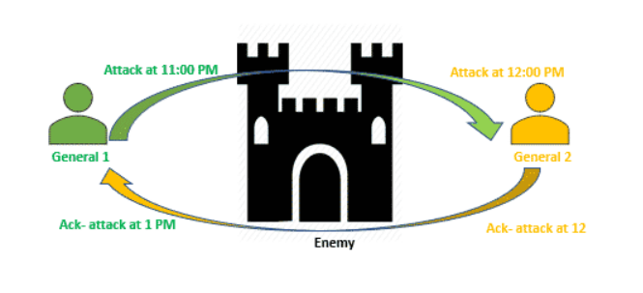
Two General Problem
First general sends a messenger across the enemy camp that need to share the time of the attack to second general, now there may be chance that messenger is captured by enemy army and they distort the message and the correct timing details is not passed to second general as shown in above example.
Once the information is received by second general then acknowledgement of that need to be send to first general and again that messenger can be captured by army and messenger share some other timing of the attack and this acknowledgement cycle will keep on going. So, this problem seems to be unsolved.

Slide 52
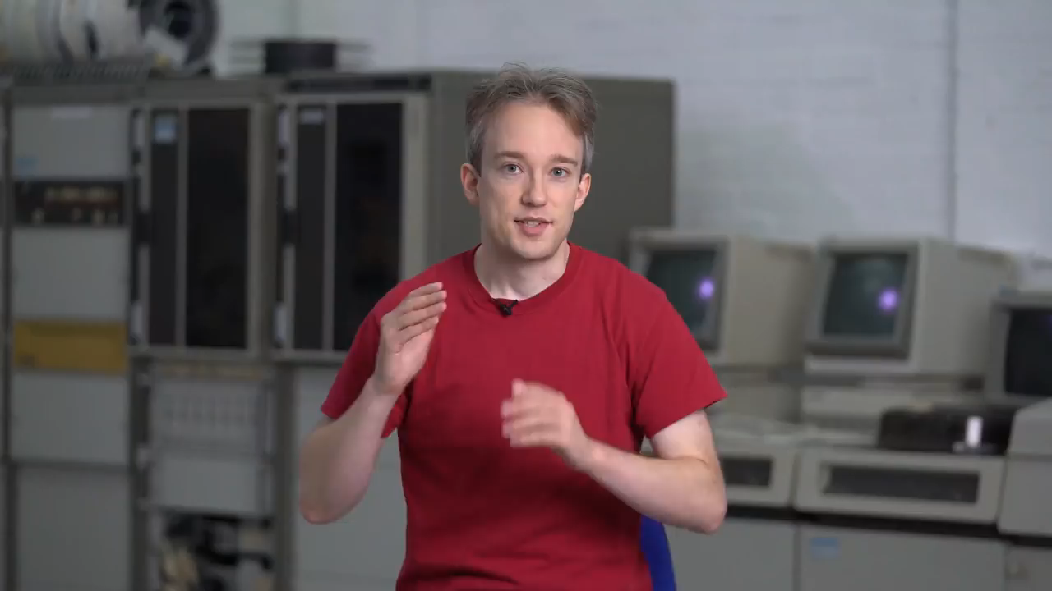
Two General Problem

Slide 53
Byzantine Generals PRoblem
Byzantine Generals Problem is advance version of “Two general problem” where there can be many generals and they need not to agree only on time of attack but here one or more than one general can be traitor.
So the question comes how consensus can be reached, answer to that is, consensus is reached when 2/3 of the actors are honest. If the traitors are more than 1/3, consensus is not reached, the armies do not coordinate their attack and the enemy wins.

Slide 54
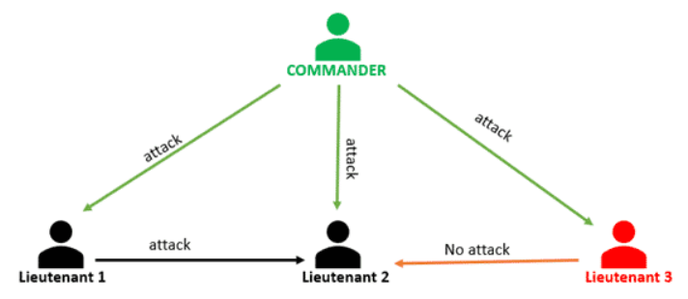
Byzantine Generals PRoblem
This should be clear from below diagram where we are seeing Lieutenant 2’s point of view.
In this scenario, Lieutenant 3 is traitor. As shown in above diagram,
Commander sends "attack" command to all Lieutenants
Lieutenant-1 sends "attack" command to Lieutenant-2
Lieutenant-3 sends "no attack" command to Lieutenant-2
Now Lieutenant-2 has 2 "attack" command and 1 "no attack" command so majority is "attack" so he will go with "attack" command.

Slide 55
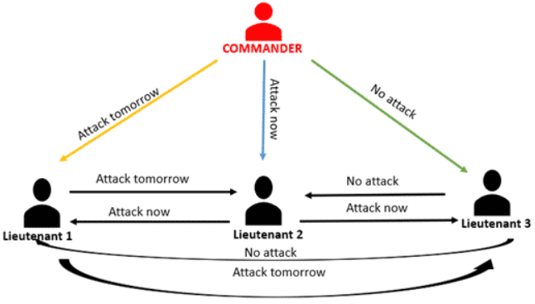
Byzantine Generals Problem
Let's consider another scenario where commander is traitor.
In this scenario, commander is traitor. As shown in diagram,
Commander sends "attack tomorrow" command to Lieutenant-1, "attack now" command to Lieutenant-2 and "no attack" command to Lieutenant-3
Lieutenant-1 sends "attack tomorrow" command to Lieutenant-2 and Lieutenant-3.
Lieutenant-2 sends "attack now" command to Lieutenant-1 and Lieutenant-3.
Lieutenant-3 sends "no attack" command to Lieutenant-1 and Lieutenant-2.
Now Lieutenant-1 will have "attack tomorrow", "attack now" and "no attack" command. since there is no majority so he will retreat.
same apply to other Lieutenants as well.

Slide 56
Quantum Computing in Blockchain
Quantum computing is the use of quantum phenomena such as superposition and entanglement to perform computation. Computers that perform quantum computations are known as quantum computers.
Quantum superposition is a fundamental principle of quantum mechanics. It states that, much like waves in classical physics, any two (or more) quantum states can be added together ("superposed") and the result will be another valid quantum state; and conversely, that every quantum state can be represented as a sum of two or more other distinct states.
Quantum entanglement is a physical phenomenon that occurs when a pair or group of particles is generated, interact, or share spatial proximity in a way such that the quantum state of each particle of the pair or group cannot be described independently of the state of the others, including when the particles are separated by a large distance.
In quantum computing, a qubit or quantum bit (sometimes qbit) is the basic unit of quantum information—the quantum version of the classical binary bit physically realized with a two-state device. A qubit is a two-state (or two-level) quantum-mechanical system, one of the simplest quantum systems displaying the peculiarity of quantum mechanics.

Slide 57
Quantum Blockchain
Quantum blockchain can be understood as a decentralized, encrypted and distributed database based on quantum computation and quantum information theory.
Once the data is recorded in the quantum blockchain, it will not be maliciously tampered with.
In recent years, the development of quantum computation and quantum information theory makes more and more researchers focus on the research of quantum blockchain.

Slide 58
Effects of Quantum Computing on Blockchain
In the context of quantum computing, we are confronted with two aspects of invalidating the promises of blockchain. First, the inversion of hashes is assumed to be computationally difficult.
If this can be dramatically simplified by a quantum computer, the authenticity of the upstream blockchain can no longer be guaranteed and the authenticity of entries in the blockchain is compromised.
Blockchain relies on the computation of hashes to provide security against modification of the past blocks.

Slide 59
Effects of Quantum Computing on Blockchain
Grover’s algorithm is specifically a solution to the problem of finding a pre-image of a value of a function that is difficult to invert.
If we are given a signature that is the hash value of some data 𝑠 = 𝐻(𝑑), and the function 𝐻(𝑑) can be implemented on a quantum computer, then Grover’s algorithm allows us to find 𝑑 for a given 𝑠 in time of order 𝑂(√𝑛) where 𝑛 is the size of the space of valid hashes.
In other words, it allows us to generate hash collisions more efficiently than brute force search, which would be 𝑂(𝑛). For a hash of length 𝑘 bits this means that we have a significant speedup by a factor of 2 ^{𝑘/2}.
This can be very large even for small values of 𝑘.

Slide 60
Effects of Quantum Computing on Blockchain
Grover’s algorithm can be used in two ways to attack the blockchain.
The first, and most obvious, is that it can be used to search for hash collisions which can be used to replace blocks without disturbing the integrity of the blockchain.
The second is that it can speed up the generation of hashes, potentially to the point that entire chains of records can be recreated with consistent modified hashes sufficiently quickly to undermine the integrity of the chain.
In both cases the algorithm is used to find the pre-image of a given value under a difficult to invert function.

Slide 61
Effects of Quantum Computing on Blockchain
As a secondary threat, in any aspect of a blockchain implementation that uses public/private key cryptography, whether it be in information exchange between parties or in digital signatures, a quantum computer may be able to break the security of the encryption.

Slide 62
Thank you

